Slide 1
Interlocking Legalities of the Chinese Presence in Latin America and Its Perception: Theory, Operationalization, and Impact in Columbia
Larry Catá Backer W. Richard and Mary Eshelman Faculty Scholar; Professor of Law and International Affairs; Pennsylvania State University | 239 Lewis Katz Building, University Park, PA 16802 1.814.863.3640 (direct) || lcb11@psu.edu
“The Legal Dimensions of China’s Presence in Latin America”
Organized by Dr. Monika Prusinowska (University of Barcelona) and Dr. Daniel Sprick (University of Cologne); University of Barcelona 12 February 2025

Slide 2
The Questions/Issue
Macro-Theoretical
Ideological interpretation through utilization of host state legalities
Legal-Normative transposition through practice and choices rather than through legal change
Micro-Operational
Do Columbian subsidiaries or controlled entities of Chinese firms have Chinese characteristics

Slide 3
Pathways
This Introduction
The theoretical basics (China)
fulfillment in corporate form and practice
Public and Private entities
The structural realities
The structures of direct outbound investment
Operational Level interpenetration in action
Chinese host state enterprise within chains of ownership and control

Slide 4
Context
1989-2013
Trajectories of macro convergence
Characteristics—internationalism, legality
2013-
Trajectories of fractured convergence
Brussels Effect mania
Silk Roads
Interpretation of ideologically differentiated trade pathways
Border, competition, and structural coupling

Slide 5
Theoretical Basics: The Chinese Political-Economic Model
Formal Expression
State Constitution
“affirms, in legal form, the achievements of the struggles of the Chinese people of all ethnic groups and stipulates the fundamental system and task of the state.”
Socialist System
People’s Democratic dictatorship
CPC Constitution
The “defining feature” of the socialist system
Normative expression and program: The Basic Line
As Applied
Parallel State and Party organs

Slide 6
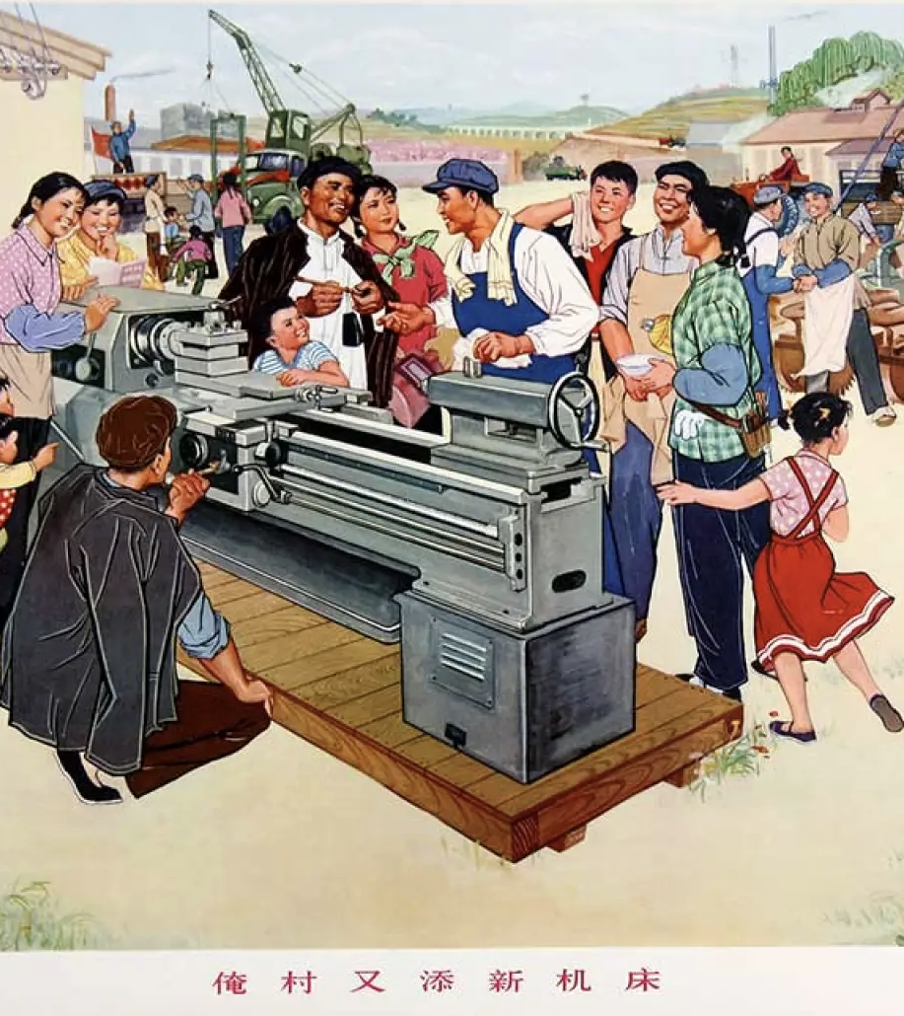
The Means of Production and the Ends of the State
“Socialist public ownership of the means of production.”
Comprehensive meaning: Economic, cultural, social, and political production
The means of production must be utilized toward the ends of advancing society along the socialist path
economic development the central task
Goals: “prosperous, strong, democratic, culturally advanced, harmonious, and beautiful”
“The general starting point and criteria for judging each item of the Party's work are that it must benefit the development of the socialist productive forces, be conducive to increasing socialist China's overall strength, and help to improve the people's living standards.”

Slide 7
The Little Engine that Could
State Enterprises
“The state sector of the economy, that is, the sector of the socialist economy under ownership by the whole people, shall be the leading force in the economy.”
Non-State Enterprises
“The state shall encourage, support and guide the development of non-public economic sectors and exercise oversight and regulation over non-public economic sectors in accordance with law.”

Slide 8
The Outward Expression of Domestic Ordering
Internal Management
SASAC (State-Party)
Statutes and corporate law
Compliance and ESG Rules
External Frameworks
BRI
State-Party oversight
Externalization of National security architecture

Slide 9
Binary Convergence
The Goal: Contribute to forward movement along the socialist path
What’s in it for host states:
Win-win architecture
Marxist-Leninist post-global international
The Path--Interpenetrative dialectics:
Local forms
Home state practices
Convergence of host state forms and practices

Slide 10
Crossing the Streams
Is there a problem here?
Interpenetration
Convergence of host state practice around the expectations and practices of home state firms
”Soft power” interface
Strict legal compliance
Bending practice to conform to needs and expectations of home state
Effects on local practice; or law?

Slide 11
Operational Level Interpenetration
Does any of this make sense on the ground?
If so, is it possible to describe and perhaps assess?
Is this evident in formal structures or operational convergence with home state?
The project question:
to what extent, or rather, how do these ideological and normative imperatives and practices shape the character and operation of Chinese assets (the means of production) when they are projected abroad in the form of direct investment, and operationalized through the instrumentalities of host state enterprise law?
中央企业境外投资应当遵循以下原则：* * * （二）依法合规。遵守我国和投资所在国（地区）法 律法规、商业规则和文化习俗，合规经营，有序发展。[The overseas investment of central enterprises shall follow the following principles: * * * (2) Compliance with laws and regulations. Abide by the laws and regulations, business rules and cultural customs of China and the country (region) where the investment is located, operate in compliance with regulations, and develop in an orderly manner]

Slide 12
The Project: Semillero de derecho societario de ICESI Cali, Columbia
Corporate forms
Baseline: indigenous corporate organization
Focus on expectations and consensus use of discretionary provisions of code
Construction of governance structures
Compliance
Chinese owned/controlled corporations and related entities
Corporate practice
Baseline: indigenous corporate governance practice
The Chinese path to corporate governance in action
Transposition of Chinese corporate practice, structures, objectives into indigenous model within the bounds of indigenous corporate law
Interpenetration
Assessment: To what extent have Chinese indigenous practice been embraced by indigenous enterprises
Compliance
Due diligence systems
Objectives hierarchies of governance and connection to public sector objectives

Slide 13
Summing Up
Convergence at the heart of Globalization
Narratives, Rules, Practices, cognitive cages
Globalization has fractured
Convergence projects have not been abandoned
Emphasis on comprehensive convergence with expression in economic activity
Americas First, Belt & Road Initiative, Brussels Effect
Contemporary battleground is Latin America
Secure production chains and converge governance models to protect interest and make it harder for competitor global systems to project power inward
Spotlight on the Chinese path to globalization and soft interpenetration
Formal compliance with law
But importing practice within those structures from home country
Consider what this suggests for hard wiring cognitive frameworks through soft practice
Analytics
Chinese theoretical-conceptual structures
Emerging internal practice
Projecting internal practice outward
The Semillero project on corporate-governance corporate practice in Columbia
Capacity building, interpenetration through practice
Where do we go from here?

Slide 14
Thanks --谢谢
Paper Introduction may be accessed HERE:
SUMMARY_INRO_Interlocking Legalities of the Chinese Presence in Latin America and Its Perception
ACCESS PPT HERE: China_LatinAmerica_Columbia_Corps_BarcelonaPresent2-2025

